Slide 1

Analysis of Global Land Average Temperature Trends
DATA ANALYSIS
By Vaishali Bokadiya
vaishalibokadiya19@gmail.com

Slide 2

Table of
CONTENTS
Project Statement
Project Overview
Azure Resources Used
Technologies Used
Architecture Diagram
About Data Set
How It Works
Execution

Slide 3

Our project is to implement data analysis using Spark SQL on Azure Databricks and process data for errors, seasonality, and anomalies.
Project Statement

Slide 4

PROJECT OVERVIEW
The goal of this project is to analyze the Global Land Average Temperature dataset to understand long-term temperature trends, detect anomalies, and identify potential factors contributing to climate change.

Slide 5

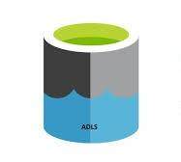


Azure resources used
Technologies Used
Azure Data Lake Storage
PySpark
Spark SQL
Azure Databricks

Slide 6
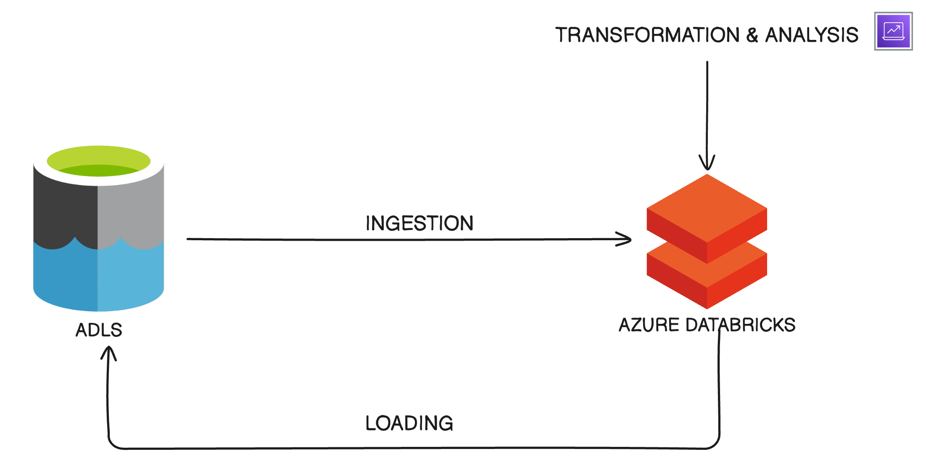
Architecture
Diagram

Slide 7

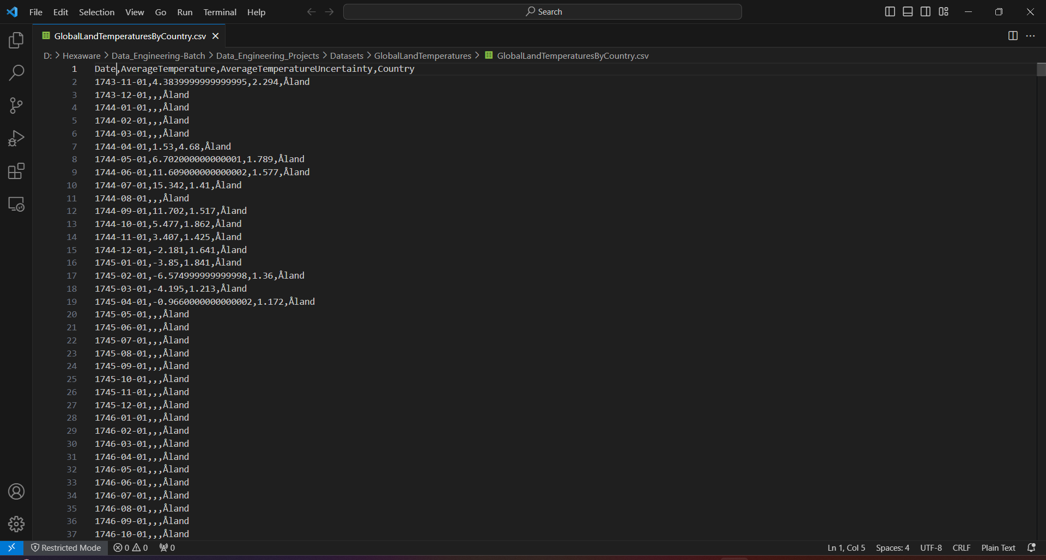
ABOUT DATASET
The Berkeley Earth Surface Temperature Study combines 1.6 billion temperature reports from 16 pre-existing archives. It is nicely packaged and allows for slicing into interesting subsets (for example by country). They publish the source data and the code for the transformations they applied. They also use methods that allow weather observations from shorter time series to be included, meaning fewer observations need to be thrown away. Our Dataset contains columns Date, Average Temperature, Average Temperature Uncertainty, Country.

Slide 8
Set up Azure Data Lake Storage
Create an Azure Databricks Workspace
Data Ingestion ( ADLS to Databricks )
How it
Data Exploration and Cleaning
WORKS
Develop Data Processing Logic in Databricks for seasonality, errors and anomalies
Data Analysis
Visualization

Slide 9
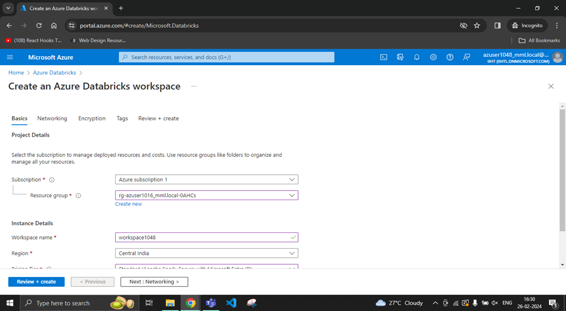
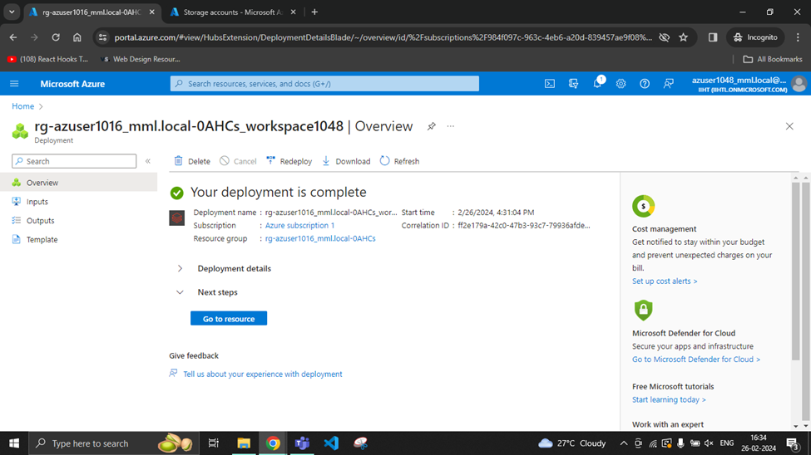
Create an Azure Databricks Workspace

Slide 10
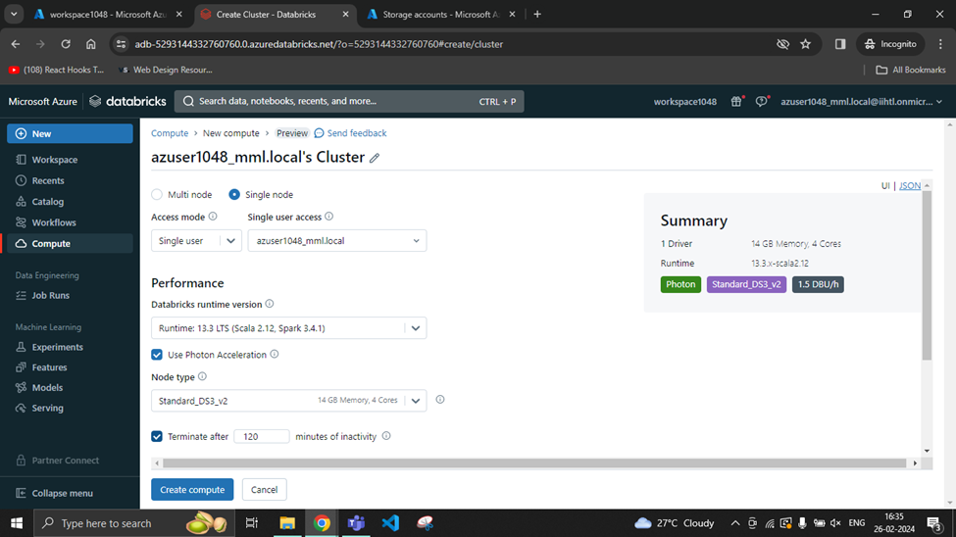
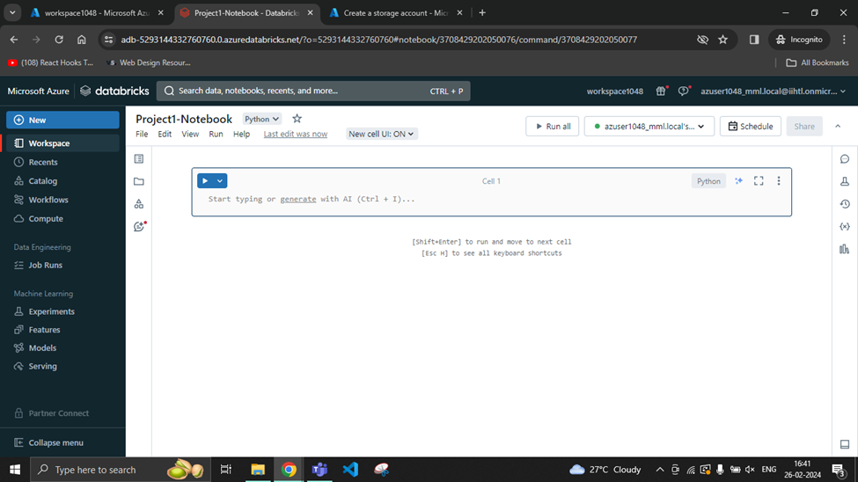
In Databricks,
create a cluster and a notebook

Slide 11
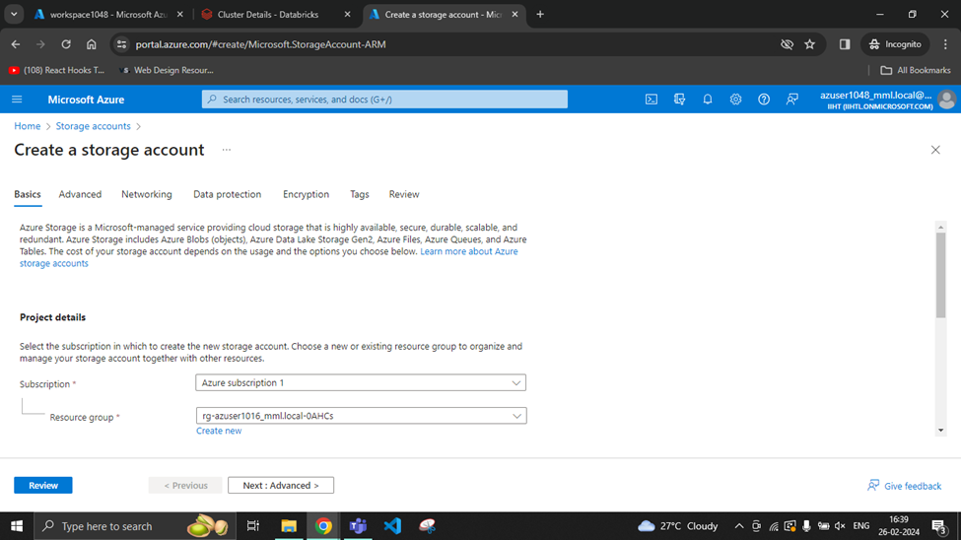
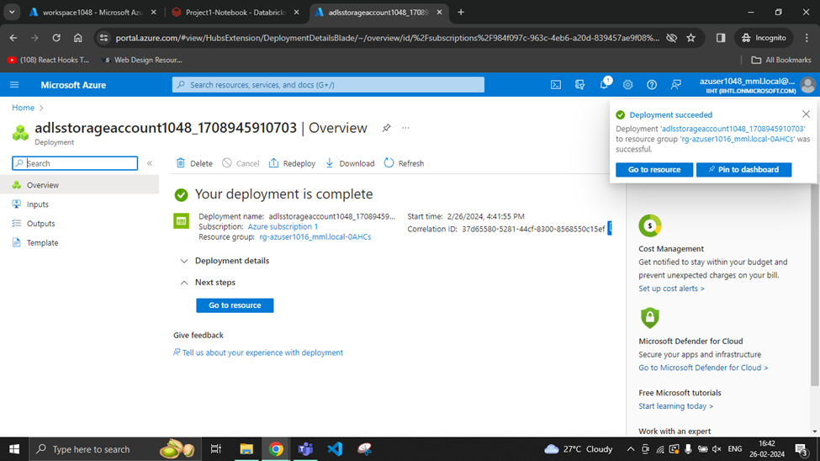
Create an
ADLS Account

Slide 12
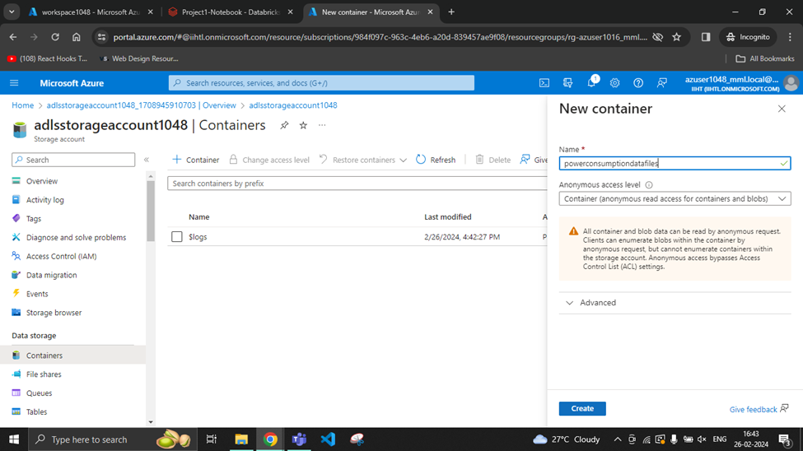
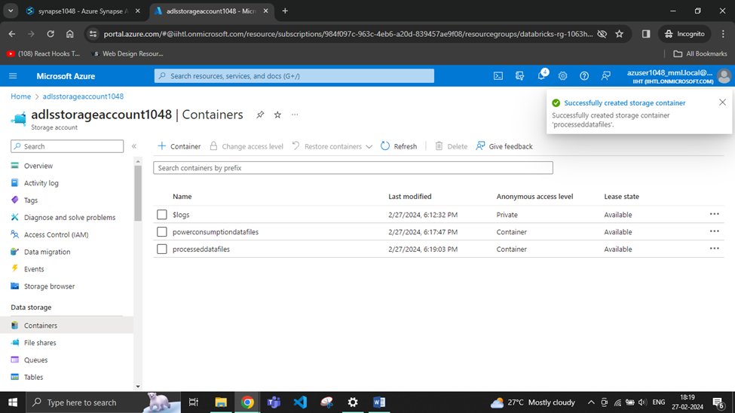
Create a
container in ADLS

Slide 13
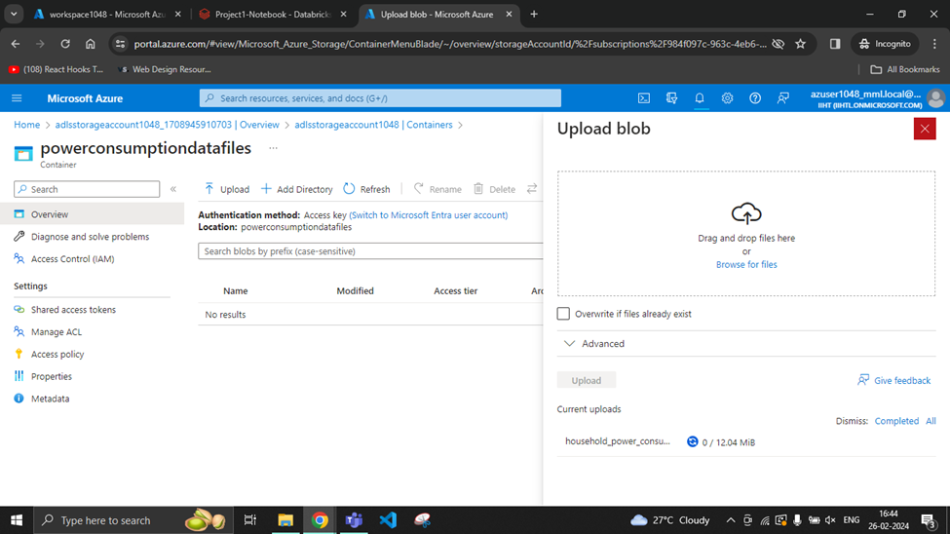
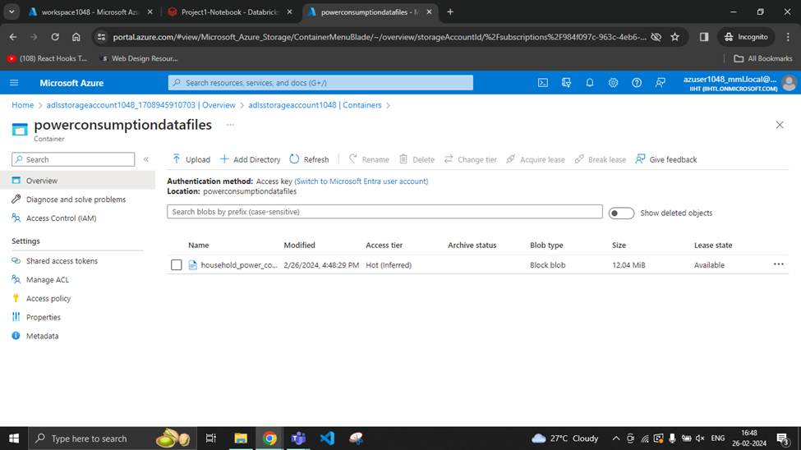
Upload the respective files in the container

Slide 14
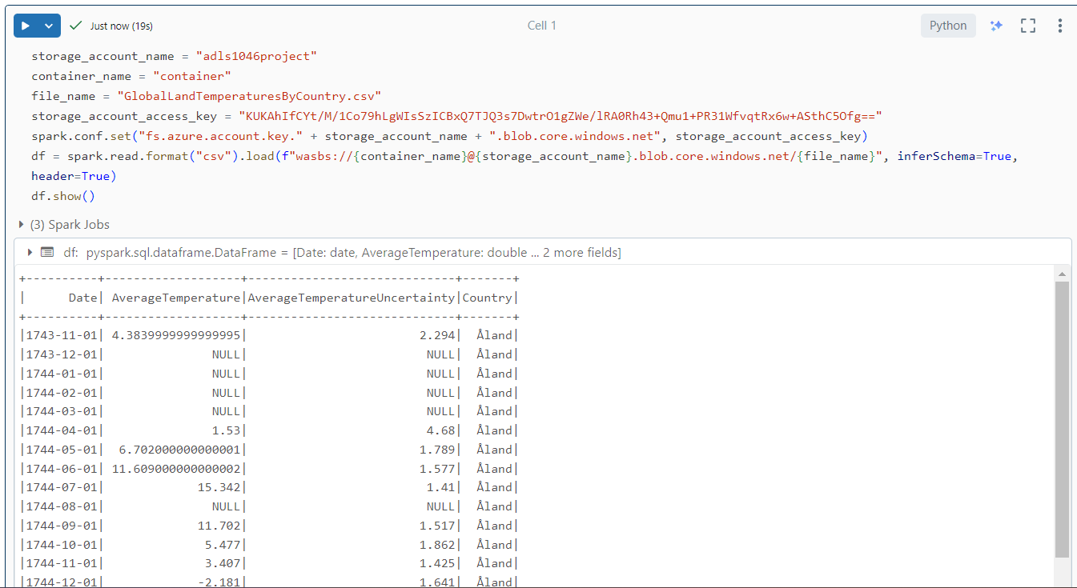
Data Preparation
Loaded the global temperature data into Spark DataFrame from our data source Azure Blob Storage.

Slide 15
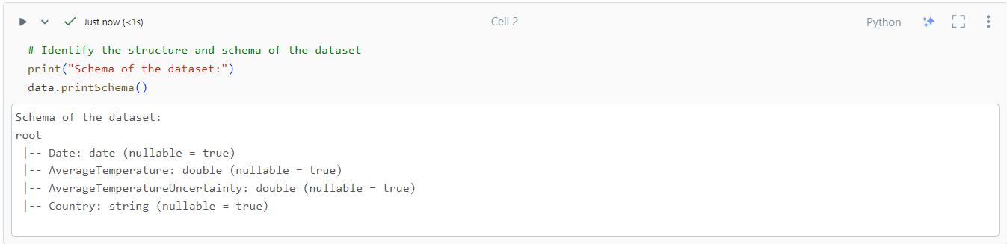
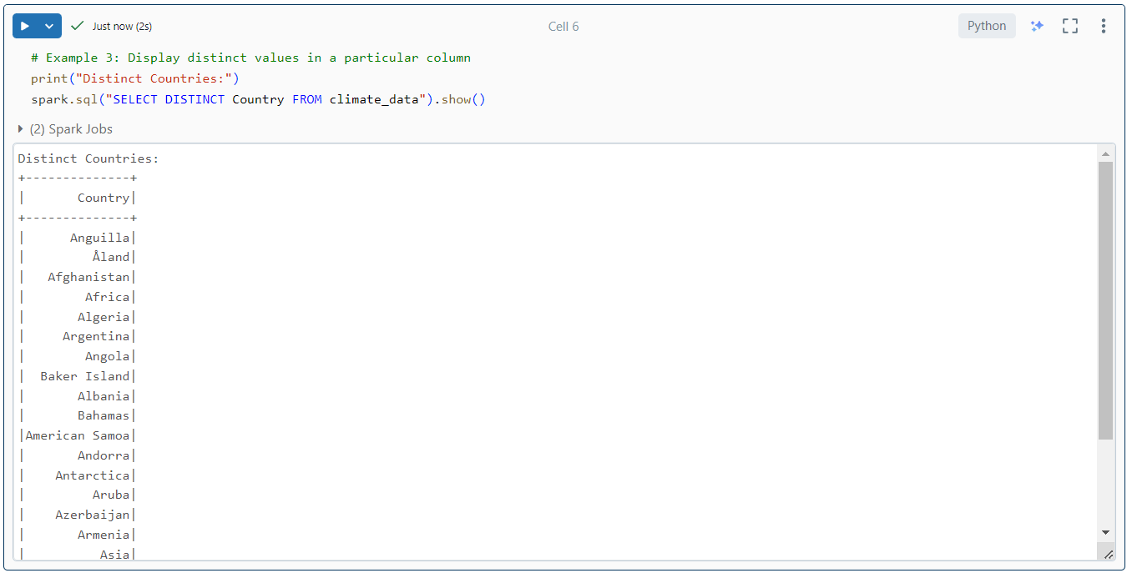
Data Exploration
Used Spark SQL queries to explore the data, including identifying the structure, schema, and basic statistics.

Slide 16
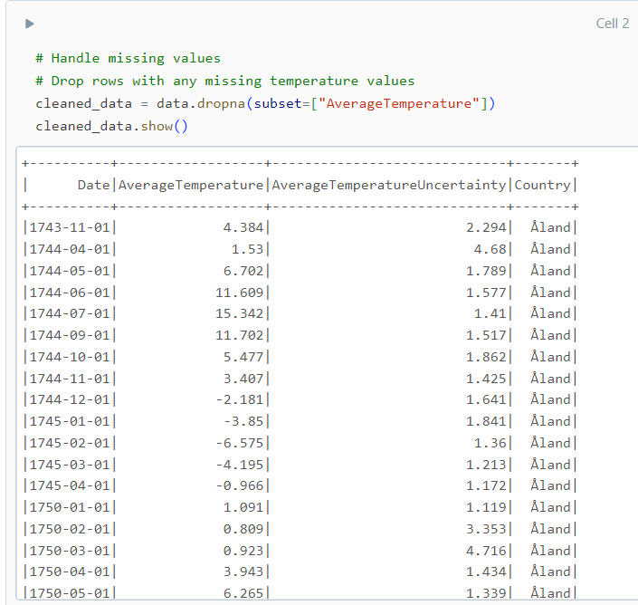
Data Cleaning
Used Spark SQL queries or DataFrame operations to perform data cleaning operations to inspect the data and to handle missing values,and any inconsistencies in the data.

Slide 17
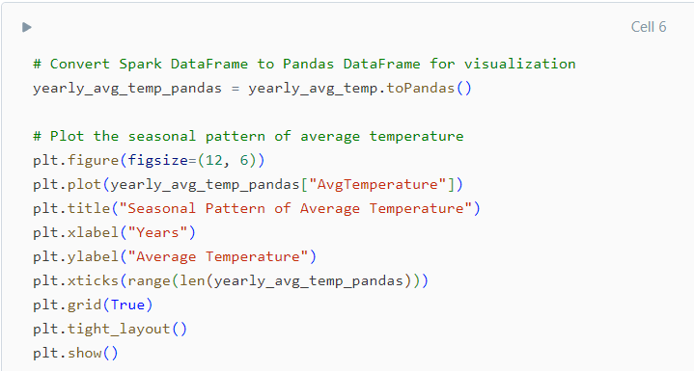
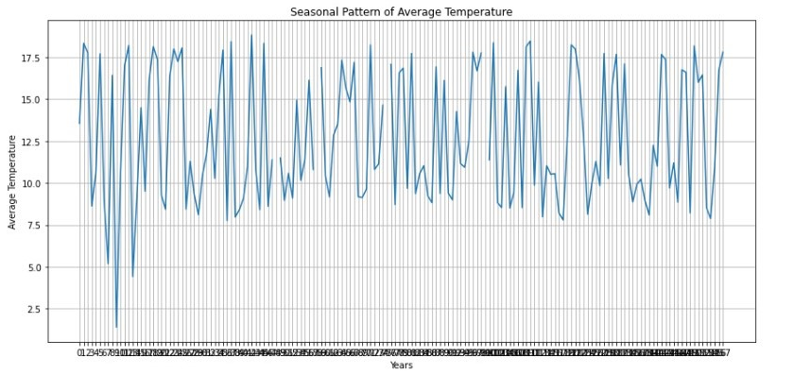
Seasonality Analysis
Use Spark SQL functions or libraries like PySpark's pandas or numpy to analyze seasonality patterns in your data.

Slide 18
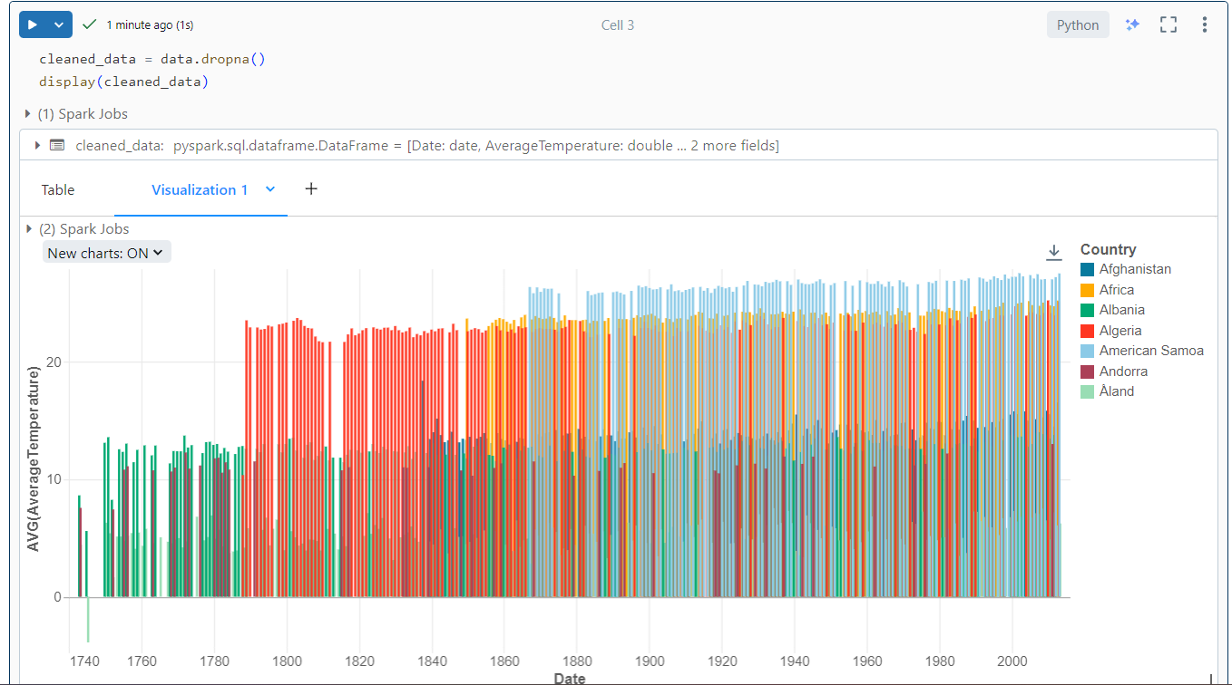
Visualization
Visualized analysis results using Databricks' built-in visualization tools.

Slide 19
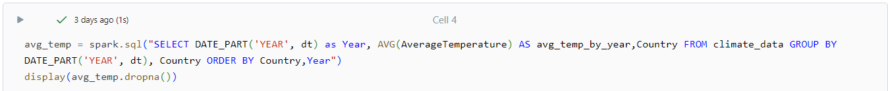
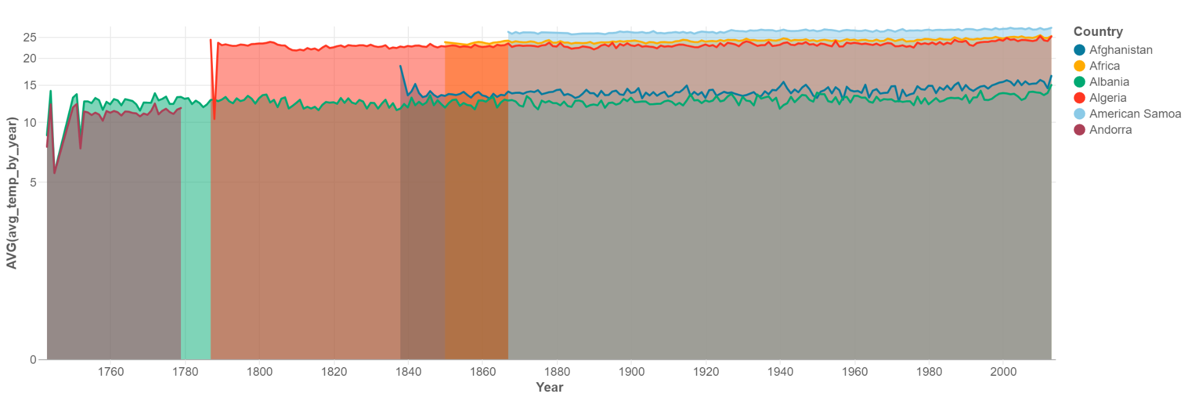
Data Analysis
Aggregate the data to calculate statistics such as average.

Slide 20

CONCLUSION
In conclusion, the project successfully achieved its objectives of analyzing the Global Land Average Temperature dataset using PySpark on Azure Databricks. By leveraging distributed computing capabilities and advanced analytics techniques, the project provided actionable insights into temperature trends and anomalies, contributing to efforts to understand and address climate change.
The project demonstrates the power of using cloud-based data analytics platforms like Azure Databricks and PySpark for processing and analyzing large-scale environmental datasets, enabling data-driven decision-making and fostering scientific research in climate science and related fields.

